Slide 1

Optimizing Tcl Bytecode
Donal Fellows
University of Manchester / Tcl Core Team
donal.k.fellows@manchester.ac.uk

Slide 2
Outline
A refresher on Tcl Bytecode
Improving compilation Coverage
Improving bytecode Generation
A script-readable bytecode Disassembler
Towards a true bytecode Optimizer
Measured effects on Performance
Some future Directions

Slide 3

Bytecode
A refresher on Tcl

Slide 4
Tcl Evaluation Strategy
Code stored as script (string)
When required, bytecode interpretation added
  Stored in Tcl_Obj internal representation
Bytecode evaluated in stack-based engine
  Example: set c [expr {$a + $b}]
    loadScalar1 %v0 # var "a"
    loadScalar1 %v1 # var "b"
    add
    storeScalar1 %v2 # var "c"
    pop

Slide 5
Looking at Bytecode
tcl::unsupported::disassemble
  Introduced in Tcl 8.5
    Same functionality as was achieved in earlier versions by setting tcl_traceCompile global
  Compiles what it is told, if necessary
  Disassembles the bytecode
    But not if done by TDK compiler
  Returns a human-readable representation

Slide 6
Disassembly Example
% tcl::unsupported::disassemble script {puts "a-$b-c"}
ByteCode 0x0x4e210, refCt 1, epoch 3, interp 0x0x31c10 (epoch 3)
Source "puts \"a $b c\""
Cmds 1, src 13, inst 14, litObjs 4, aux 0, stkDepth 4, code/src 0.00
Commands 1:
1: pc 0-12, src 0-12
Command 1: "puts \"a $b c\""
(0) push1 0 # "puts"
(2) push1 1 # "a-"
(4) push1 2 # "b"
(6) loadScalarStk
(7) push1 3 # "-c"
(9) concat1 3
(11) invokeStk1 2
(13) done

Slide 7
What’s Wrong with Bytecode?
Variable length instructions
  Many common opcodes come in multiple sizes
Funky encoding for various lengths
  Command metadata might as well be read-only!
Very hard to improve overall
  Can extend with new opcodes
  Can compile individual commands better
  Global optimizations much more challenging

Slide 8

Coverage
Improving compilation

Slide 9
Improving Coverage
Tcl assembler showed potential
  tcl::unsupported::assemble
In theory, bytecode compiled commands are easier to optimize
  Can prove safety theorems about them
  Uncompiled commands are hard
    Just push arguments and invokeStk; no semantics
  Fully-bytecoded procedures can support more analysis
To get benefit, needed to increase fraction of compiled commands

Slide 10
Which to tackle?
Prioritize by requirement for code we want to go fast
  As little overhead in inner loops as possible
Prioritize by how common
  Little benefit to tackling very rare commands
Filter by how possible
  Command compilers are non-trivial
Filter by how fixed in function
  Bytecode locks in implementation strategy

Slide 11
Methodology
Identify which commands used in key inner loops
  Study samples from various performance discussions
    comp.lang.tcl, Wiki, tcl-core, private emails
Identify which commands used to generate literals
  Not just expr and subst!
  Official return -level 0 was known, but non-obvious
    lappend x [if {$y} {set y} else {return -level 0 "no"}]

Slide 12
Methodology
Identify commands with subcommands (“ensembles”)
  Collect list of all literal subcommands used in packages in ActiveTcl Teapot repository
  Ignore subcommand names from a variable
  Collate/sort by frequency
  Manually filter for actual subcommands
find $TEAPOTDIR -type f -print0 | xargs -0 cat
| grep --binary-files=text -w $CMD
| sed "s/.*$CMD *\\([a-z]*\\).*/\\1/"
| sort | uniq -c | sort -n

Slide 13
Subcommand Frequencies
string
dict
namespace
array
1 string totitle
2 string replace
8 string trimleft
33 string trimright
34 string repeat
145 string toupper
147 string trim
248 string tolower
424 string is
28 string last
245 string index
569 string map
674 string first
898 string match
892 string range
1100 string length
2129 string equal
5971 string compare
1 dict keys
8 dict values
1 dict with
2 dict unset
3 dict lappend
8 dict for
15 dict merge
18 dict incr
22 dict create
28 dict append
34 dict exists
297 dict get
347 dict set
3 namespace forget
6 namespace inscope
7 namespace parent
17 namespace children
50 namespace exists
77 namespace delete
130 namespace import
153 namespace origin
269 namespace ensemble
757 namespace export
2681 namespace eval
30 namespace qualifier
56 namespace which
116 namespace code
132 namespace upvar
206 namespace tail
272 namespace current
37 array size
479 array get
1085 array names
56 array exists
191 array unset
2511 array set

Slide 14
Commands with New Compilers
array
  array exists
  array set
  array unset
dict
  dict create
  dict merge
format
  Simple cases only
info
  info commands
  info coroutine
  info level
  info object class
  info object isa object
  info object namespace
namespace
  namespace code
  namespace current
  namespace qualifiers
  namespace tail
  namespace which
regsub
  Simple cases only
self
  self namespace
  self object
string
  string first
  string last
  string map
    Simple cases only
  string range
tailcall
yield
Notes:
Outliers: string last (since functionality needed elsewhere anyway)
Namespace eval, array get and array names not present: too complex to get right!

Slide 15
Future Compiled Commands?
Minor
    low impact
    low difficulty
  concat
  eval
  namespace origin
  string trim
  string trimleft
  string trimright
  string tolower
  string toupper
Major
    high impact
    high difficulty
  array get
  array names
  namespace eval
  next
  string is
  uplevel
  yieldto

Slide 16
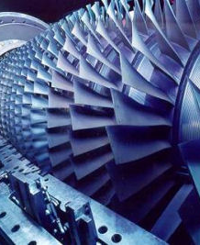
Generation
Improving bytecode

Slide 17
Improving Generation:
“list concat” via expansion
Making list {*}$foo {*}$bar efficient
  Now a sort of “lconcat” (for all combinations of arguments)
Compare old and new versions
Old
New
(0) expandStart
(1) push1 0 # "list"
(3) loadScalar1 %v0 # var "foo"
(5) expandStkTop 2
(10) loadScalar1 %v1 # var "bar"
(12) expandStkTop 3
(17) invokeExpanded
(0) loadScalar1 %v0 # var "foo"
(2) loadScalar1 %v1 # var "bar"
(4) listConcat
Notes:
Previous code for expanding list was just a variation on push args and invoke; now it does direct list construction in TEBC

Slide 18
Improving Generation: Ensembles
Bind core ensembles to their implementations
  Apply basic syntax checks
    Number of arguments
  Replace ensemble call with direct call to correct implementation command if possible
  Otherwise, use special ensemble dispatch
    Half the mechanism…
Not for user-defined ensembles
  Would be very bad for Snit!
% disassemble script {info body foo}
[…]
(0) push1 0 # "::tcl::info::body"
(2) push1 1 # "foo"
(4) invokeStk1 2
(6) done
% disassemble script {string is space x}
[…]
(0) push1 0 # "string"
(2) push1 1 # "is"
(4) push1 2 # "space"
(6) push1 3 # "x"
(8) push1 4 # "::tcl::string::is"
(10) invokeReplace 4 2
(16) done
Notes:
TODO: Example bytecode

Slide 19
Improving Generation
Expanding the set of cases for which existing compilers generate “good” code
  Avoid doing complex (expensive!) exception processing when no exceptions are present
  Especially the try…finally compiler
  Also dict with with an empty body
Generating jumps for break and continue
  Even when inside expansion inside nested evaluation inside…

Slide 20

Disassembler
A script-readable bytecode

Slide 21
Improving Inspection
tcl::unsupported::getbytecode
  Currently on a development branch,
  dkf-improved-disassembler
Returns a script-readable version of the disassembly
  Dictionary of various things
Lots of interesting things inside
  Opcodes, variables, exception handlers, literals, commands, …
Can easily build useful tools on top
  Example next slide…

Slide 22
Example: foreach loop
::tcl::unsupported::controlflow lambda {{} {
foreach foo $bar {
puts [list {*}$foo {*}$bar]
break
}
} ::tcl}
0 loadScalar1 %bar
2 storeScalar1 %%%4
4 pop
5 foreach_start4 {data %%%4 loop %%%5 assign %foo}
┌──► 10 foreach_step4 {data %%%4 loop %%%5 assign %foo}
│ ┌─ 15 jumpFalse1 ➡ 35
│ │ 17 push1 "puts"
│ │ 19 loadScalar1 %foo
│ │ 21 loadScalar1 %bar
│ │ 23 listConcat
│ │ 24 invokeStk1 2
│ │ 26 pop
│┌┼─ 27 jump4 ➡ 35
│││ 32 pop
└┼┼─ 33 jump1 ➡ 10
└┴► 35 push1 ""
37 done
Notes:
Red is (loop) exception range. 10 is range continue target, 35 is range break target. Indented part is detected loop.
Live demo here? Use: make shell SCRIPT=flowdemo.tcl | less –RS
(If doing this yourself, use the font Courier New for your terminal as it has better glyph definitions for this sort of thing.)

Slide 23
Inside the Disassembly Dict
literals
  List of literal values
variables
  List of variable descriptors (name, temporary, other flags)
exception
  List of exception ranges (definitions of where to go when an opcode throws an error, a break or a continue)
instructions
  Dictionary of instructions and arguments, indexed by address
auxiliary
  List of extra information required by some instructions (foreach, etc.)
commands
  List of information about commands in the bytecode (source range, bytecode range)
script
  Literal script that was compiled
namespace
  Name of the namespace to which the sbytecode is bound
stackdepth
  Maximum depth of execution stack required
exceptdepth
  Maximum depth of nested exceptions required

Slide 24
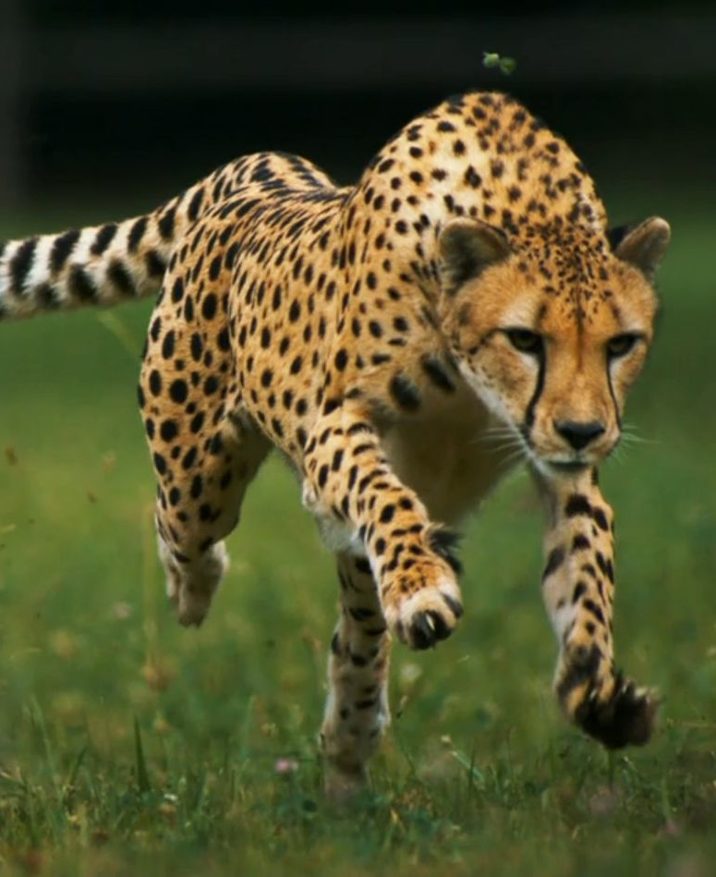
Optimizer
Towards a true bytecode

Slide 25
Optimization
Tcl now has a formal bytecode optimizer
  Initial aim: fewer peephole optimizations in bytecode engine
  Very early days!
Part of 8.6.1
Depends on very efficient handling of multi-“nop” sequences in bytecode engine

Slide 26
Current Optimizations
Strip “startCommand” where possible
  Inside ::tcl, and
  With fully-bytecoded procedures that do not create variable aliases
Converts zero-effect operations to “nop”s
  “push anyLiteral; pop”
  “push emptyLiteral; concat”
Tidies up chains of jumps
  Avoid jumping to another jump if possible
Strips some entirely unreachable operations

Slide 27
Much still to do
A number of fundamental optimizations needed
  Control flow analysis
    “pop” hoisting to clean up if branches
  Reordering of instructions
  Full dead code elimination
Optimize Tcl using Tcl
  Close the assembler gap
  Care required!
    Optimizing the optimizer could be hard to debug…

Slide 28

Performance
Measured effects on

Slide 29
Methodology
All timings done with same build and execution environment
Measure time to execute a small script
  Careful to avoid most performance problems
Invert to get calls/sec
  “Performance”
Normalize
proc Fibonacci {n} {
set a 0
set b 1
for {set i 2} {$i <= $n} {incr i} {
set b [expr {$a + [set a $b]}]
}
return $b
}
proc benchmark {title script} {
eval $script
for {set i 0} {$i < 20} {incr i} {
lappend t [lindex [
time $script 100000
] 0]
}
puts [format "%s: %4f" $title \
[tcl::mathfunc::min {*}$t]]
}
benchmark ”Fibonacci" {Fibonacci 10}

Slide 30
Raw Performance (time/iter)
Program | 8.5.9 | 8.5.15 | 8.6b1 | 8.6b2 | 8.6.0 | 8.6.1
ListConcat | 1.1609 | 0.4097 | 1.5622 | 0.5405 | 0.5433 | 0.4737
Fibonacci | 1.5906 | 1.2710 | 1.8087 | 1.4340 | 1.4620 | 1.4114
ListIterate | 3.3059 | 3.0234 | 3.5981 | 2.1105 | 2.1232 | 2.1599
ProcCall | 1.1510 | 0.8695 | 1.4590 | 1.3083 | 1.3039 | 1.2996
LoopCB | 1.6978 | 1.0508 | 1.8496 | 1.4095 | 1.4581 | 1.5382
EnsDispatch1 | 1.6907 | 1.0425 | 2.0192 | 1.3988 | 1.4293 | 0.9404
EnsDispatch2 | 1.0189 | 0.4875 | 1.4117 | 0.9670 | 0.3406 | 0.3763
EnsDispatch3 | 1.9381 | 0.5133 | 1.5587 | 1.2390 | 1.2585 | 1.1909
EnsDispatch4 | 0.9240 | 0.4369 | 1.2799 | 0.7928 | 0.7925 | 0.8167
DictWith | 3.7534 | 2.5671 | 4.1987 | 1.9461 | 1.2926 | 1.3514
TryNormal | N/A | N/A | 27.2137 | 1.4110 | 1.4075 | 0.5086
TryError | N/A | N/A | 39.1749 | 3.8483 | 3.8556 | 3.9413
TryNested | N/A | N/A | 58.8109 | 7.6793 | 7.6454 | 11.9620
TryNestedOver | N/A | N/A | 40.3560 | 4.1359 | 4.1963 | 4.3093
}
New concat
General
Operations
}
Ensembles
}
dict with
try
Notes:
Performance on [try] for 8.5 not tested; command not present

Slide 31
Raw Speed

Slide 32
Performance

Slide 33
Relative Performance
“Lehenbauer Level 1” Better!
Better
Worse
Normalized to mean of 8.5-series performance (8.6 for try)
Notes:
8.6b2 universally faster than 8.6b1
EnsDispatch1 measures ensemble dispatch converted to implementation invoke
EnsDispatch2 measures ensemble dispatch converted to direct bytecodes
EnsDispatch3 measures ensemble dispatch via new invoke scheme
EnsDispatch4 measures user-defined ensemble dispatch

Slide 34
Performance Measurement Highlights
8.6 is not universally faster
  Procedure calls pay a real penalty (NRE)
8.6.0 is not universally faster than betas
  But you probably don’t want to worry about that
  8.6b2 universally faster than 8.6b1
8.6.1 is sometimes much faster than 8.6.0
  try now about as cheap as catch when no error
System binary may not be built in fastest mode
Which C compiler really matters

Slide 35
Implications for Optimization
Improving the compilation of commands provides the biggest gain
  But only for code that uses those commands
  Doesn’t deliver a quantum leap for most
General optimization has had little impact so far
Answering “Is Tcl getting faster?” is hard
  Some things are faster, some are not
  “It depends”
    We can easily answer for particular scripts
  How should we weight each sample script to get an overall figure?

Slide 36

Directions
Future

Slide 37
Where next?
Integrate “getbytecode” into trunk
  Name?
Compile more commands
  Some of the biggest wins will be very hard to get right
  Some should be done without immediate wins, because they strengthen the type algebra
Compile more cases with existing commands?
Can we optimize in Tcl?
  Definitely can’t do so yet; can’t assemble foreach

Slide 38
Where next?
The command dispatch mechanism is quite a bit more expensive in 8.6
  Can we improve it?
  Several performance tests very sensitive to this
    That’s one reason why no TclOO benchmarks this time
    Warning! Might be optimizing for benchmarks, not for reality
Can we inline sufficiently simple procedures?
  Suspect it is fairly easy for variable-free code
  Only really relevant with some variables…

Slide 39
Where next?
Can we generate native code?
  Topic for Tcl 9.0!
  Automatic type annotations are key
The Lehenbauer Challenges
  Attaining even Level 1 (speed ×2) is hard
    Arguably the case for a few scripts
  Level 2 (×10) is extremely difficult!
    Bytecode engine is not fast enough

