Slide 1
Tcl/Tk Conference 2012
Patterns for Iteration
Phil Brooks
November 15, 2012

Slide 2
Purpose of the talk
Explore the concept of iteration through collections in Tcl
  Start from foreach and Tcl lists
  Focus on the context of embedded C interfaces
  How do other applications do iteration?

Slide 3
Context Application
Calibre
  Electronic Design Tool
  Design Verification
  Large Datasets
  Extensive user programmability
    SVRF
    Tcl

Slide 4
How Calibre uses Tcl
GUI
TVF - SVRF Code Preprocessing
Yield Server – Database Exploration
LVS Device Recognition
  Measurements
  Device Reduction
Numerous other uses

Slide 5
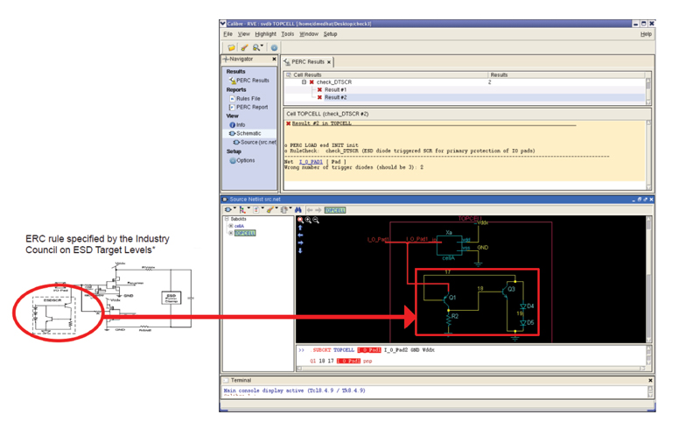
Gui
Tcl/Tk provides much of the interactive gui

Slide 6
SVRF
SVRF is the geometric manipulation language for Calibre
  L3 = L1 AND L2

Slide 7
SVRF can be generated with Tcl (TVF)
SVRF has a Tcl interface that works as an SVRF preprocessor:
  foreach layer { L3 L4 L5 } {
  tvf::SETLAYER “New_layer$idx” = L2 AND L$idx
  }
Works as a big script that produces text (SVRF)

Slide 8
Yield Server
Yield Server provides capabilities for exploring and manipulating result databases.
Shell environment with customized command interfaces.
  cells - hierarchical design entitiesi
    small things like inverters
    large things like graphics subsystems or memories
  ports – interface to things outside the chip
  nets – connections between cells, devices, and ports
  devices (transistors, resistors, etc.)
  Individual geometries

Slide 9
Device Recognition (LVS)
In Device Recognition
  ‘once-per-device-instance’ basis providing access to measurement information for individual devices.
In Device Reduction
  Accumulation of properties for a set of devices.
Called Tcl script environment for making customized calculations

Slide 10
Iteration Styles
foreach with a Tcl List
Indexed access
Iterator interface
Specialized foreach commands
Coroutines

Slide 11
List Based Iteration
Iteration over a list:
  proc do_calculation input_list {
  # now iterate
  set val 0.0
  foreach var $input_list {
  set val [ expr { $val + $var }
  }
  return $val
  }
You can’t use foreach with C api objects directly
Unless you construct a Tcl List

Slide 12
Constructing a Tcl List from C
  //
  // Tcl List construction from a C++ std::vector<double>
  //
  Tcl_Obj *command[2];
  command[0] = Tcl_NewStringObj( proc_name.c_str(), -1 );
  Tcl_IncrRefCount(command[0]);
  command[1] = Tcl_NewObj(); Tcl_IncrRefCount(command[1]);
  for( std::vector<double>::iterator i = data.begin();
  i != data.end(); ++i )
  {
  Tcl_ListObjAppendElement(interp, command[1],
  Tcl_NewDoubleObj( *i ));
  }

Slide 13
Indexed
Useful when conversion to a list is too expensive
Provides random access to virtual contents
  proc do_calculation my_arr {
  set entry_count [ $my_arr entry_count ]
  # iterate using an index
  set val 0.0
  for { set i 0 } { $i < $entry_count } { incr i } {
  set val [ expr { $val + [ $my_arr value $i ] } ]
  }
  return $val
  }

Slide 14
Indexed method Tcl command C code
  int index_interface(
  ClientData cd,
  struct Tcl_Interp *interp,
  int objc,
  Tcl_Obj *CONST objv[] )
  {
  std::vector<double>* data =
  static_cast<std::vector<double>*>(cd);
  const char* command =
  Tcl_GetStringFromObj( objv[1], NULL );
  if ( strcmp( command, "size" ) == 0 ) {
  size_t sz = data->size();
  Tcl_Obj *result=Tcl_NewLongObj(sz);
  Tcl_IncrRefCount(result);
  Tcl_SetObjResult( interp, result );
  } else if ( strcmp( command, "value" ) == 0 ) {
  ...
Notes:
passed in to Tcl_CreateObjCommand

Slide 15
Iterator
  std::vector<double>::iterator i = data.begin();
  while ( i != data.end() ) {
  std::cout << *i << std::endl
  ++i;
  }
  proc do_calculation { data } {
  set my_iter [ $data get_iterator ]
  set val 0.0
  while { ! [$data at_end $my_iter] } {
  set val [ expr { $val + [ $data value $my_iter ] } ]
  $data incr $my_iter
  }
  return $val
  }
Notes:
Tcl_CreateCommandObj

Slide 16
Iterator Implementation
Tcl_CreateCommandObj is used to create the $data object that represents the st::vector
  get_iterator
  at_end
  incr
  value
a Tcl_ObjType object is created to implement the vector iterator (i.e. pointer to the current member).
  sits on top of the std::vector::iterator
  the iterator has to be carefully tracked and invalidated

Slide 17
Specialized foreach command
  proc do_calculation record { data } {
  set val 0.0
  foreach_instance value $record {
  set val [ expr { $val + $value } ]
  }
  return $val
  }

Slide 18
Specialized foreach command
Specialized foreach command can be implemented either in Tcl or in C/C++
Tcl:
  proc foreach_instance { var1 record body } {
  set vlen [ $record size ]
  upvar 1 $var1 value# now iterate
  for { set i 0 } { $i < $vlen } { incr i } {
  set value [$record value $i]
  uplevel 1 $body
  }
  }
Notes:
C is just another command obj

Slide 19
Coroutines!
It is possible, using coroutines, to hide the data access inside a coroutine – the end user’s interface then looks something like:
  proc do_calculation { data_fetcher } {
  set val 0.0
  while 1 {
  set val [ expr { $val + [ data_fetcher ] } ]
  }
  }

Slide 20
Coroutines
The application end of the Tcl code looks like:
  coroutine data_fetcher get_from_record $record
  proc get_from_record record {
  yield [ info coroutine ]
  foreach value $record {
  yield $value
  }
  return -code break
  }

Slide 21


www.mentor.com

