Slide 1
F5, iRules, & Tcl
– The how & Why
Colin Walker, @colin_walker
Senior Solution Developer

Slide 2
F5:
What’s an F5?

Slide 3
Where did we start?
Load balance inbound traffic
“Advanced” routing
Balance outbound links
Simple LB features:
  Persistence
  Monitoring for HA
  Rate limiting
  Etc.

Slide 4



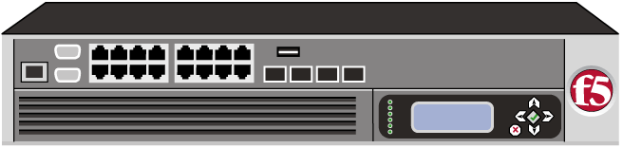
What do we do now?
Requests
Modified Request*
Modified Responses*
*Note: BIG-IP’s Bi-Directional Proxy capabilities allow it to inspect, modify and route traffic at nearly any point in the traffice flow, regardless of direction.
Original Request
Route
Load Balance
Inspect
Protect
Block
Modify
Profile
And on….and on…
Generate
Mimic
Optimize
Sanitize
Direct
Replay
Duplicate

Slide 5
Multiple products for multiple solutions:
Access Management via APM (SSL VPN, tunneling, authentication offloading, etc.)
Global Load Balancing via GTM (DNS based LB for multiple data centers)
Web Application Security via ASM (Layer 7 application firewall, detection, filtering, prevention, learning and integration with scanners)
Web Acceleration via WA (Caching, Compression, Image optimization, Content Re-ordering, IBR and more)
Application Delivery via LTM (Application awareness, load balancing, monitoring, SSL offloading, and much more)
… and more.

Slide 6
What makes an F5 device unique?
Bi-Directional Proxy
  Separate IP stacks
  Full packet inspection
  Application aware
Traffic Management Operating System (TMOS)
  Includes a fully customized Micro Kernel (TMM) for traffic management
  CMP/DAG
  Memory management and scaling
Unsurpassed flexibility and control
  Open API (iControl)
  Powerful template engine (iApps)
  Ground breaking and still market leading network side scripting (iRules)
Notes:
talk up the DC community support here

Slide 7
iRules:
What, why, and how?

Slide 8
What makes iRules tick?
iRules allow you to perform deep packet inspection (entire header and payload)
Programming language integrated into TMOS
Based on industry standard TCL language
    Tool Command Language
Provide ability to intercept, inspect, transform, direct and track inbound or outbound application traffic
Coded around Events (HTTP_REQUEST, HTTP_RESPONSE, CLIENT_ACCEPTED etc.)
Request
Processing
On Request:
Response
Request Arrives at server (possibly modified)
Session Begins
iRules Request Events Executed
Server Processes as needed
Response data is sent to client
Request info Processed, modifications made, persistence applied, etc.
User Requests Data
Client’s connection is established
Request data passed to “server”
Virtual Server Processes Request
On Response:
iRule Response Events Executed
Response Data Processed
Response sent to client

Slide 9
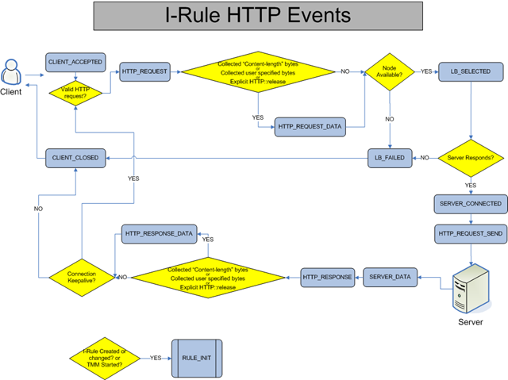
iRules: Event Driven

Slide 10
iRule Overview Events
LINE
CLIENT_LINE
SERVER_LINE
TCP
CLIENT_ACCEPTED
CLIENT_CLOSED
CLIENT_DATA
SERVER_CLOSED
SERVER_CONNECTED
SERVER_DATA
USER_REQUEST
USER_RESPONSE
LINE
TCP
GLOBAL
LB_FAILED
LB_SELECTED
RULE_INIT
AUTH
AUTH_ERROR
AUTH_FAILURE
AUTH_RESULT
AUTH_SUCCESS
AUTH_WANTCREDENTIAL
GLOBAL
AUTH
RTSP
RTSP_REQUEST
RTSP_REQUEST_DATA
RTSP_RESPONSE
RTSP_RESPONSE_DATA
RTSP
HTTP
HTTP_CLASS_FAILED
HTTP_CLASS_SELECTED
HTTP_REQUEST
HTTP_REQUEST_DATA
HTTP_REQUEST_SEND
HTTP_RESPONSE
HTTP_RESPONSE_CONTINUE
HTTP_RESPONSE_DATA
HTTP
CACHE
CACHE_REQUEST
CACHE_RESPONSE
CACHE
UDP
CLIENT_ACCEPTED
CLIENT_CLOSED
CLIENT_DATA
SERVER_CLOSED
SERVER_CONNECTED
SERVER_DATA
UDP
SIP
SIP_REQUEST
SIP_REQUEST_SEND
SIP_RESPONSE
SIP
CLIENTSSL
CLIENTSSL_CLIENTCERT
CLIENTSSL_HANDSHAKE
CLIENTSSL
IP
CLIENT_ACCEPTED
CLIENT_CLOSED
CLIENT_DATA
SERVER_CLOSED
SERVER_CONNECTED
SERVER_DATA
SERVERSSL
SERVERSSL_HANDSHAKE
IP
SERVERSSL
XML
XML_BEGIN_DOCUMENT
XML_BEGIN_ELEMENT
XML_CDATA
XML_END_DOCUMENT
XML_END_ELEMENT
XML_EVENT
XML
DNS
DNS_REQUEST
DNS_RESPONSE
NAME_RESOLVED
DNS
STREAM
STREAM_MATCHED
STREAM
Notes:
There are two methods for easily applying this template to your presentation.
Method One: Change this file
1. Save this file with a new name (File-Save As…)
2. Change and add slides
Method Two: Apply the attributes of this file to an existing presentation
1. Open the existing presentation
2. Select Format-Apply Design…
3. In the Apply Design dialog box:
At Files of Type: choose “Presentations and Shows”
At Look In: navigate to this file and select it
Click Apply
4. Go through your file and adjust slides as necessary

Slide 11
iRules Common Tasks
Inspection based routing to a pool or node
HTTP request redirection
Inspection based persistence
Protocol agnostic request or response modifications
Header inspection and modification
Custom user experience (retries, custom error pages, etc.)
Selective and/or advanced content encryption
Session or connection rate limiting
Network offloaded client authentication
Conditional configuration activation (Selective SNATing, etc.)

Slide 12
iRules History
v4.x
  Originally implemented as custom commands
  Inbound only
  Limited scope
v9.x
  Benefited from full-proxy (bi-directional)
  Rapid adoption and innovation
  DevCentral exploded with discussion, research, documentation and examples
  iRules became a major selling point and differentiator
iRules began helping to steer the product roadmap in some areas
v10
  Class restructure
  Table command
  Proliferation of even more advanced, “Next Level” iRules
v11
  Side band connections
  iStats
  … profit
What’s next?

Slide 13
Why Tcl?
Speed
Usability
Embeddability
Subset Usage Anyway
“The Full Tcl Syntax can be described as just a handful of rules. In fact, it’s so simple you could write your own Tcl grammar parser in an afternoon. For contrast, only Perl can understand Perl.” – F5 Alpha Geek / Engineer
https://devcentral.f5.com/Tutorials/TechTips/tabid/63/articleType/ArticleView/articleId/1088516/iRules-Concepts-Tcl-The-How-and-Why.aspx

Slide 14
What we get by using Tcl
Self cleaning (errors, memory management, doesn’t hang onto memory at error)
String based language (we assumed that most people would be doing string manipulation)
Extremely easy to extend and play by the rules. We knew we needed to add a massive amount of functionality
Portability (possible to transfer to other languages)
Complex internal types - open command able to just pass around file handles and get them back
Namespacing - no variable name collisions
Tight byte code loop, high scalability
Stable and reliable, almost to a fault - still running 8.4.6
Pre-compilation syntax checking
Single pass conversion (saves overhead, only convert from string to IP address once, excellent)

Slide 15
What have we changed?
Hundreds of new commands
Dozens of events
Network awareness
Proxy state awareness
And most of all – Suspension
Direct access to Tcl from within TMM, no need to make external calls

Slide 16
iRules:
What can they do?

Slide 17


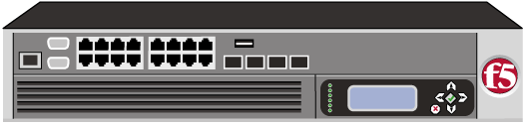
Session Persistence
2
1
4
3
1
A first web request received by BIG-IP application delivery platform. BIG-IP chooses a server
and forwards the request
2
When the request returns BIG-IP notes the specified session id (JSESSIONID, PHPSESSIONID, etc..)
in its session table along with the server and returns the request to the browser
3
A second request is received. The BIG-IP application delivery platform extracts the session id cookie
and determines to which server the request should be sent based on its session table
4
Request is sent to the same server, preserving session state in the web application

Slide 18
Session Persistence
when HTTP_REQUEST {
if { [HTTP::cookie exists "JSESSIONID"] } {
persist uie [HTTP::cookie "JSESSIONID"]
} else {
set jsess [findstr [HTTP::uri] "jsessionid" 11 ";"]
if { $jsess != "" } {
persist uie $jsess
}
}
}

Slide 19
Cookie Tampering Prevention
3
1
2
1
Creates a hash for each cookie returned from server
2
Creates new cookie and stores each hash and then encrypts the cookie
3
Upon request, decrypts cookie containing hashes and compares to new hash generated from each cookie
Notes:
This is one you can’t

Slide 20
Cookie Tampering Prevention
when HTTP_RESPONSE {
foreach c_name [HTTP::cookie names] {
binary scan [md5 [HTTP::cookie $c_name]] H* hexhash
append cookie_hash $c_name " " $hexhash " "
}
HTTP::cookie insert name $static::h_cookie value $cookie_hash
HTTP::cookie encrypt $static::h_cookie $static::key
}
when HTTP_REQUEST {
if { [HTTP::cookie exists $static::h_cookie] }{
set d_cookie [HTTP::cookie decrypt $static::h_cookie $static::key]
if { !($d_cookie equals "") }{
foreach {c_name c_value} $d_cookie {
binary scan [md5 [HTTP::cookie $c_name]] H* hexhash
if { !($c_value equals $hexhash)}{
HTTP::respond 200 content "<HTML><BODY>Cookie tampering detected, offending cookie $c_name did not match original content. Please contact an administrator.</BODY></HTML>"
TCP::close
return
}
}
}

Slide 21
SMTP TLS-Offloading
1
2
3
4
1
Mail request received by BIG-IP application delivery platform. BIG-IP examines the request and
determines if the transport is using TLS
2
BIG-IP responds with the appropriate syntax to begin an encrypted connection
3
BIG-IP handles all the TLS (encryption) while talking plain text to mail servers
4
BIG-IP returns responses encrypted to the client

Slide 22
SMTP TLS-Offloading
when CLIENT_ACCEPTED {
SSL::disable
}
when SERVER_CONNECTED {
TCP::collect
}
when CLIENT_DATA {
set lcpayload [string tolower [TCP::payload]]
if { $lcpayload starts_with "ehlo" } {
TCP::respond "250-STARTTLS\r\n250 OK\r\n"
TCP::payload replace 0 [TCP::payload length] ""
TCP::release
TCP::collect
} elseif { $lcpayload starts_with "starttls" } {
TCP::respond "220 Ready to start TLS\r\n"
TCP::payload replace 0 [TCP::payload length] ""
TCP::release
SSL::enable
} else {
TCP::respond "530 Must issue a STARTTLS command first\r\n"
TCP::payload replace 0 [TCP::payload length] ""
TCP::release
TCP::collect
}
}
when SERVER_DATA {
TCP::release
clientside { TCP::collect }
}

Slide 23
LDAP Connection Proxy
1
2
4
3
1
Request received by BIG-IP application delivery platform. BIG-IP examines the request by looking at the TCP
payload and finds the string that represents the unbind command.
2
BIG-IP releases the client binding to the LDAP server
3
BIG-IP keeps the TCP connection to the LDAP server open for reuse
4
The original unbind command is discarded and LDAP server’s overhead reduced

Slide 24
LDAP Connection Proxy
when CLIENT_ACCEPTED {
TCP::collect
}
when CLIENT_DATA {
binary scan [TCP::payload] xc ber_len
if { $ber_len < 0 } {
set ber_index [expr 2 + 128 + $ber_len]
} else {
set ber_index 2
}
# message id
binary scan [TCP::payload] @${ber_index}xcI ber_len ber_len_ext
if { $ber_len < 0 } {
set ext_len [expr 128 + $ber_len]
set ber_len [expr (($ber_len_ext>>(4-$ext_len)*8)+(0x100^$ext_len))%(0x100^$ext_len)]
} else {
set ext_len 0
}
incr ber_index [expr 2 + $ext_len + $ber_len]
# ldap message
binary scan [TCP::payload] @${ber_index}c ber_type
if { [expr $ber_type & 0x1f] == 2 } {
log local0. "unbind => detach"
TCP::payload replace 0 [TCP::payload length] ""
LB::detach
}
TCP::release
TCP::collect
}

Slide 25
Data Scrubbing
1
2
4
3
1
Web request received by BIG-IP application delivery platform. BIG-IP examines the request and
determines to which server it should be sent.
2
Request sent to appropriate web application server where processing occurs normally
3
BIG-IP recognizes that the response contains a credit card number. The iRule “scrubs” the number
by replacing all digits in the credit card number with an X
4
BIG-IP returns the response with the “clean” data to the browser

Slide 26
Data Scrubbing
when HTTP_RESPONSE {
# Only check responses that are a text content type
# (text/html, text/xml, text/plain, etc).
if { [HTTP::header "Content-Type"] starts_with "text/" } {
# Get the content length so we can request the data to be
# processed in the HTTP_RESPONSE_DATA event.
if { [HTTP::header exists "Content-Length"] } {
set content_length [HTTP::header "Content-Length"]
} else {
set content_length 1000000000
}
if { $content_length > 0 } {
HTTP::collect $content_length
}
}
}
when HTTP_REQUEST {
# Don't allow data to be chunked
if { [HTTP::version] eq "1.1" } {
if { [HTTP::header is_keepalive] } {
HTTP::header replace "Connection" "Keep-Alive"
}
HTTP::version "1.0"
}
}

Slide 27
when HTTP_RESPONSE_DATA {
# Find ALL the possible credit card numbers in one pass
set card_indices [regexp -all -inline -indices {(?:3[4|7]\d{2})(?:[ ,-]?(?:\d{5}(?:\d{1})?)){2}|(?:4\d{3})(?:[ ,-]?(?:\d{4})){3}|(?:5[1-5]\d{2})(?:[ ,-]?(?:\d{4})){3}|(?:6011)(?:[ ,-]?(?:\d{4})){3}} [HTTP::payload]]
foreach card_idx $card_indices {
set card_start [lindex $card_idx 0]
set card_end [lindex $card_idx 1]
set card_len [expr {$card_end - $card_start + 1}]
set card_number [string range [HTTP::payload] $card_start $card_end]
# Remove dash or space if they exist and count the occurences in variable cutouts.
set cutouts [regsub -all {[- ]} $card_number "" card_number]
# Adjsut card_len variable but keep it for later use.
set new_card_len [expr {$card_len - $cutouts}]
set double [expr {$new_card_len & 1}]
set chksum 0
set isCard invalid
# Calculate MOD10
for { set i 0 } { $i < $new_card_len } { incr i } {
set c [string index $card_number $i]
if {($i & 1) == $double} {
if {[incr c $c] >= 10} {incr c -9}
}
incr chksum $c
}
# Determine Card Type
switch [string index $card_number 0] {
3 { set type AmericanExpress }
4 { set type Visa }
5 { set type MasterCard }
6 { set type Discover }
default { set type Unknown }
}
# If valid card number, then mask out numbers with X's
if { ($chksum % 10) == 0 } {
set isCard valid
HTTP::payload replace $card_start $card_len [string repeat "X" $card_len]
}
# Log Results
log local0. "Found $isCard $type CC# $card_number"
}
}

Slide 28
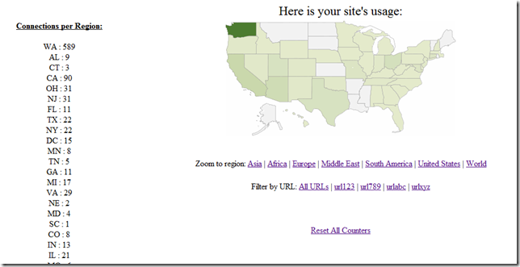
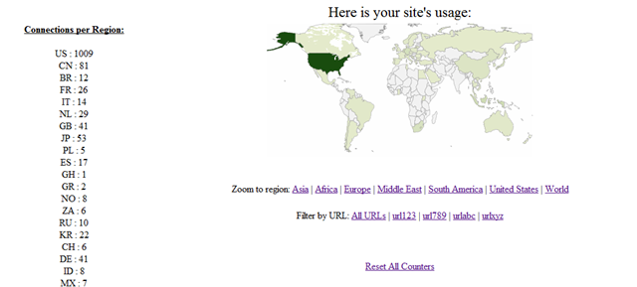
Example: “Heatmaps” via iRules
Geo-location lookups via iRules
Regional Usage displayed
Utilizes iRule Tables feature
Fast and Efficient

Slide 29
“Heatmaps” – Actual iRule
when RULE_INIT {
set static::resp1 "<HTML><center><font size=5>Here is your site's usage by Country:</font><br><br><br><img src='http://chart.apis.google.com/chart?cht=t&chd=&chs=440x220&chtm="
set static::resp2 "&chco=f5f5f5,edf0d4,6c9642,365e24,13390a' border='0'><br><br>Zoom to region: <a href='/asia'>Asia</a> | <a href='/africa'>Africa</a> | <a href='/europe'>Europe</a> | <a href='/middle_east'>Middle East</a> | <a href='/south_america'>South America</a> | <a href='/usa'>United States</a> | <a href='/heatmap'>World</a><br><br><br><a href='/resetmap'>Reset All Counters</a></center></HTML>"
}
when HTTP_REQUEST {
switch -glob [string tolower [HTTP::uri]] {
"/asia" -
"/africa" -
"/europe" -
"/middle_east" -
"/south_america" -
"/usa" -
"/world" -
"/heatmap*" {
set chld ""
set chd ""
set zoom [string map {"/" "" "heatmap" "world"} [HTTP::uri]]
## Configure the table query to be based on the countries subtable or the states subtable ##
if {$zoom eq "usa"} {
set region "states"
} else {
set region "countries"
}
## Get a list of all states or countries and the associated count of requests from that area ##
foreach rg [table keys -subtable $region] {
append chld $rg
append chd "[table lookup -subtable $region $rg],"
}
set chd [string trimright $chd ","]
## Send back the pre-formatted response, set in RULE_INIT, combined with the map zoom, list of areas, and request count ##
HTTP::respond 200 content "${static::resp1}${zoom}&chd=t:${chd}&chld=${chld}${static::resp2}"
}
"/resetmap" {
foreach country [table keys -subtable countries] {
table delete -subtable countries $country
}
foreach state [table keys -subtable states] {
table delete -subtable states $state
}
HTTP::respond 200 Content "<HTML><center><br><br><br><br><br><br>Table Cleared.<br><br><br> <a href='/heatmap'>Return to Map</a></HTML>"
}
default {
## Look up country & state locations ##
set cloc [whereis [IP::client_addr] country]
set sloc [whereis [IP::client_addr] abbrev]
## If the IP doesn't resolve to anything, pick a random IP (useful for testing on private networks) ##
if {($cloc eq "") and ($sloc eq "")} {
set ip [expr { int(rand()*255) }].[expr { int(rand()*255) }].[expr { int(rand()*255) }].[expr { int(rand()*255) }]
set cloc [whereis $ip country]
set sloc [whereis $ip abbrev]
}
## Set Country ##
if {[table incr -subtable countries -mustexist $cloc] eq ""} {
table set -subtable countries $cloc 1 indefinite indefinite
}
## Set State ##
if {[table incr -subtable states -mustexist $sloc] eq ""} {
table set -subtable states $sloc 1 indefinite indefinite
}
HTTP::respond 200 Content "Added"
}
}
}

Slide 30
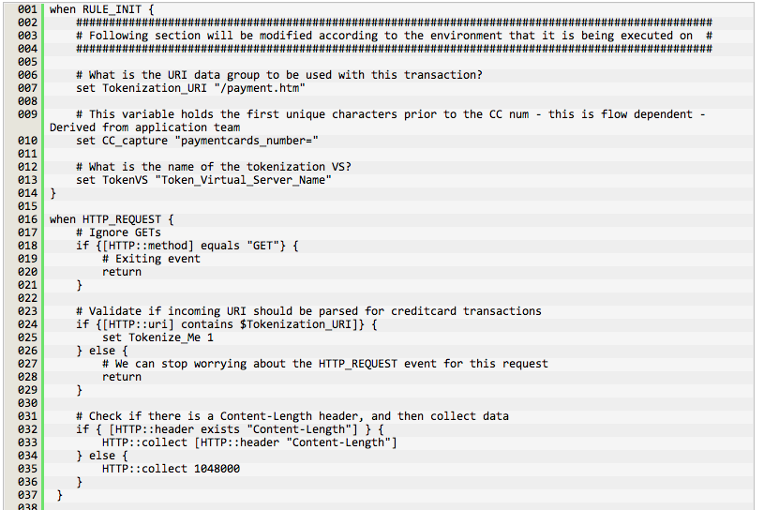
Credit Card Tokenization
Completely secure credit card data even within the LTM
A service is introduced which takes and handles the actual information
A non sensitive token is all that is passed to backend systems.
The exchanging of CC/PANs for tokens can happen at the Big-IP, potentially removing everything except the Big-IP and the edge router from audit scope.

Slide 31
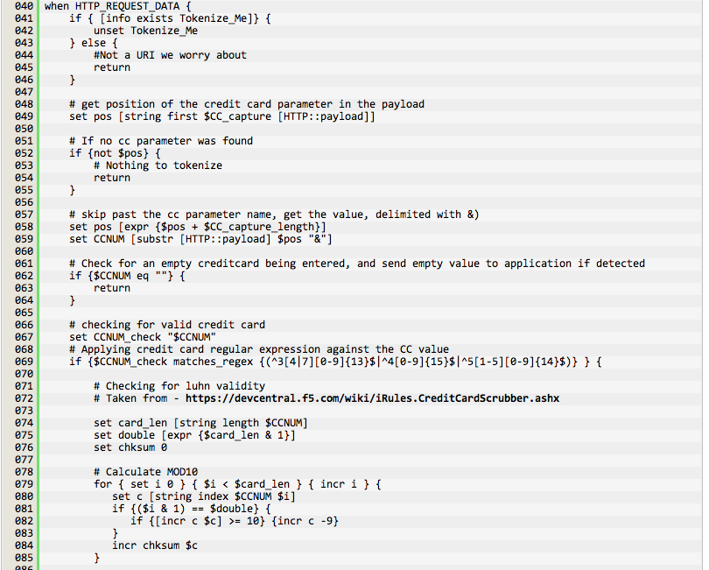
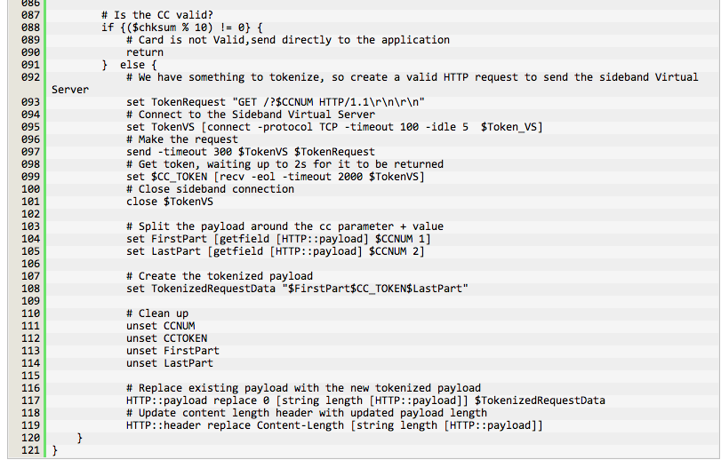
Credit Card Tokenization

Slide 32
LTM Concepts:
How does this stuff work under the covers, and how does that affect iRules?

Slide 33
Lifecycle of an iRule
User inputs code
Distributed to all TMMs
Traffic triggers a filter with an iRule event associated for execution
Configuration saved, validation occurs
iRule event and all associated code fires
Results are given, traffic is affected as necessary, and session proceeds to next filter
Compiled to bytecode

Slide 34
Clustered Multi-Processing (CMP)
What is CMP?
Our chosen method of clustering for compute resources, allowing for superiorly linear scaling.
SMP, which is a standard practice, does not scale
CMP scales nearly 100% linearly
  No shared mem locking/updates
  No queuing issues
Many individual instances of TMM
Private resources

Slide 35
Dis-aggregation (DAG)
What is DAG?
Dis-aggregation is required for CMP to work, it is the way by which we decide which we LB CPU cores.
LB your LBs
Due to CMP, we have to build intelligence into the selection of TMMs
Ensure proper load distribution
Does not run on standard CPU

Slide 36
CMP, DAG & iRules
How do these technologies affect iRules?
High performance and scalability
No true global memory/variables
“Pinning” becomes a concern
Possible multi-tenant conditions
“Workarounds” for global data storage result in command suspension.

Slide 37
TMM
TMM
TMM
TMM
CPU
CPU
TMM
TMM
TMM
TMM
LTM
TMM
TMM
TMM
TMM
CPU
CPU
TMM
TMM
TMM
TMM

Slide 38
Shared memory & iRules Suspension
What?
What is shared memory? I thought CMP meant we didn’t share…
Why?
Why do we need shared memory if each TMM processes things separately?
How?
How do we make use of shared memory if CMP is designed specifically to avoid it?
No such thing as a fully shared memory space
A “pull” is done as needed to amass TMM data and parse
This takes a “long” time, and TMM is single threaded
This led to the necessity of suspension, which is globally non-blocking
Suspension is unique to F5, and does not exist in “normal” Tcl

Slide 39
Suspending Commands
Some commands require TMM to “wait”
TMM is single threaded
While iRule is “suspended”, it pauses the iRule and allows traffic until it’s resume is hit
Things such as:
    Timeout
    Response from DNS server
    Internal communication complete

Slide 40
iRules add TCL_SUSPEND
If a command created by F5 needs time to complete, it can return TCL_SUSPEND. This will:
  Save references to the stack objects
  Record the PC
  Halt execution just like TCL_ERROR
  Put the last call frame/connflow in the pending execution list

Slide 41
Example Suspending Commands
Always suspend:
after
Conditionally suspend:
table
session
persist
RESOLV::lookup
(and others)

Slide 42
DevCentral:
If you’re not a member, you’re doing it wrong…

Slide 43
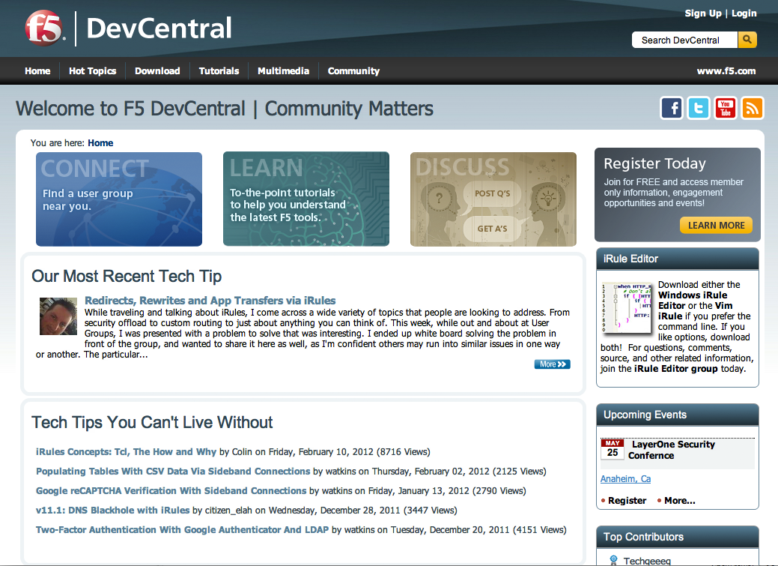
F5 DevCentral
F5’s Global Technical Community
Over 105,000 members worldwide
55% of visits originate outside U.S.
Over 60,000 Forum Posts All Time
iRules, iControl, Advanced Design/Config, ISV solutions, and more!

Slide 44
Historical Overview of DevCentral
DevCentral is F5’s global community of IT professionals that provides a unique level of collaboration not offered by any other ADN provider.
Launch of DevCentral in 2003 as a Community Forum
TechTip publishing began in 2004
DevCentral Team officially formed in 2005
Scaled to Multi DataCenters in 2005
Wiki/Codeshare added in 2005
First iRules contest 2006
Live Multimedia added in 2007
Launched Japan DevCentral 2008
Launched China DevCentral 2009
MVP Program 2009
Site Refresh and platform change in 2010
Partner, User Groups and Topical Sub Communities (Groups) launched an 2010
New wiki platform migrated and launched in 2011
Regional blogs added in 2011
Full Cloud Deployment 2012
Engage
Enable
Connect
Learn

Slide 45
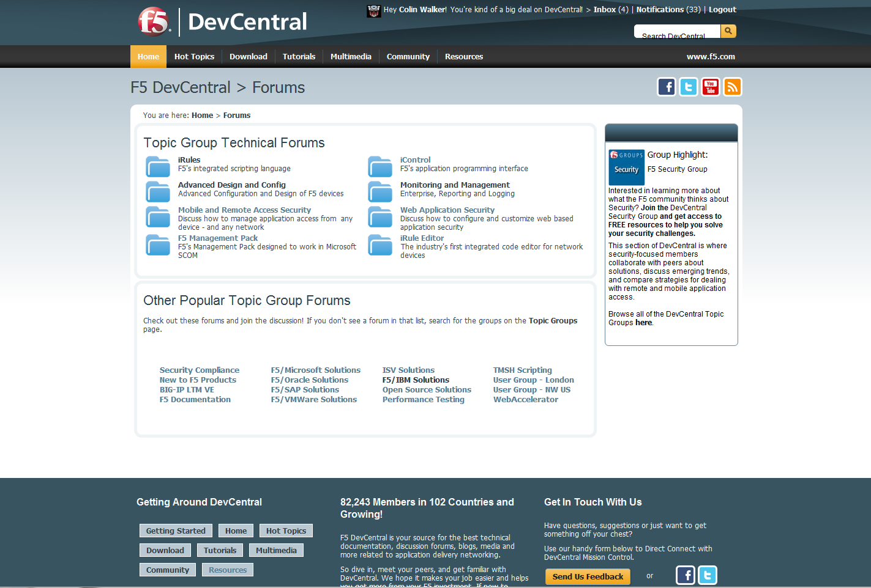
F5 DevCentral – Discussion Forums
Forums provide one place to ask technical questions about iControl, iRules, FirePass and Wan Optimization
Questions answered by F5 technical experts and other community members
Over 25,000+ messages posted by community members

Slide 46
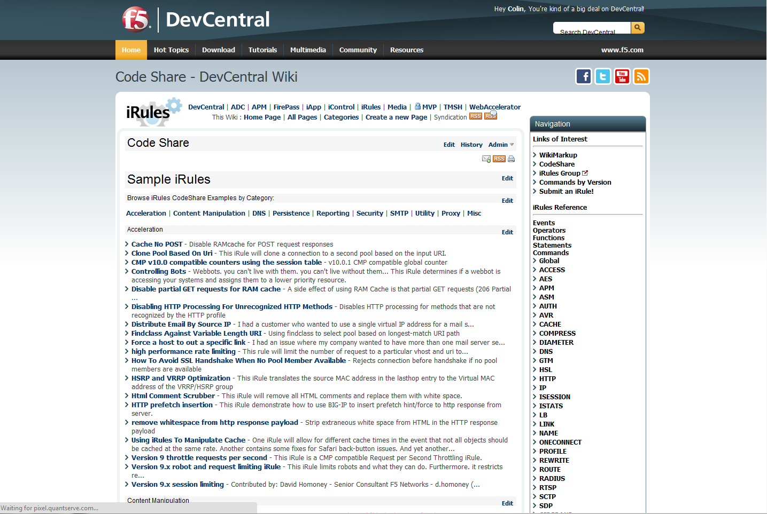
F5 DevCentral – Codeshare
CodeShare provides public repository for sharing iRules
Sharing is made easy through wiki interface, iRule Editor “share” function
Over 200 contributions by the community

Slide 47
Beyond the examples:
What should I know?

Slide 48
Solving problems with iRules
Application changes are costly
  Making changes to an enterprise application is often extremely costly. iRules allows you to make needed changes quickly and easily, without compromising your application, or inducing extensive cycles of re-testing.
Large scale code management is time consuming
  Managing any changes, especially frequent ones, to data distributed across possibly hundreds of systems is extremely time consuming and often error prone. By consolidating the management of data into a single point, your LTM, iRules allows you to maintain a single copy of the data and make changes once.
Scalability via hardware can be costly and sometimes even inefficient
  iRules allows the network layer to become a part of your application and work with you, allowing you to offload portions of your application logic that function much better and more efficiently on the LTM than they ever could on your back end servers.
iRules can see it all
  Given our placement in the network and our ability to do in-depth packet inspection on anything on the wire, there really isn’t anywhere else in the application flow where you’re likely to have as much information about what’s going on or what just happened as you can with the LTM and iRules. Even when the application doesn’t have all the necessary pieces of data, and the client can’t see it all, iRules likely can.

Slide 49
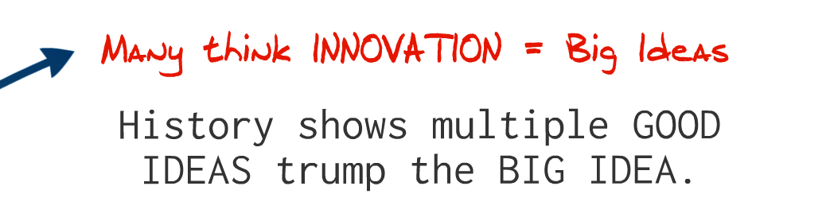
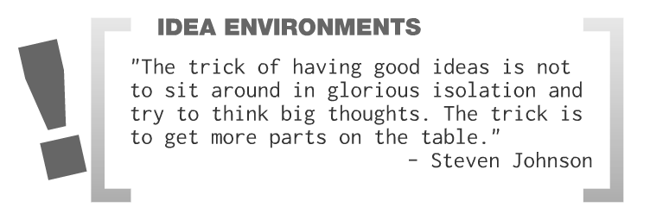


Slide 50
Questions?
Know How. Now.

