Slide 1

Tcl Summer of Code

Slide 2
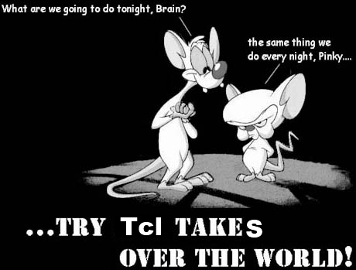

Slide 3

Agenda
About GSoC
Program stages - subjectively
Applying - notices
Startup – notices
Impressions

Slide 4
What is GSoC?
GSoC = Google Summer of Code
  Scholarship program for students

Slide 5
What is all about?
Goals:
- „philanthropy”
- have something done
for Tcl! :)
- gain new Tcl users

Slide 6
Stages
Applying
Startup
Work in progress
Finalizing
And…?

Slide 7
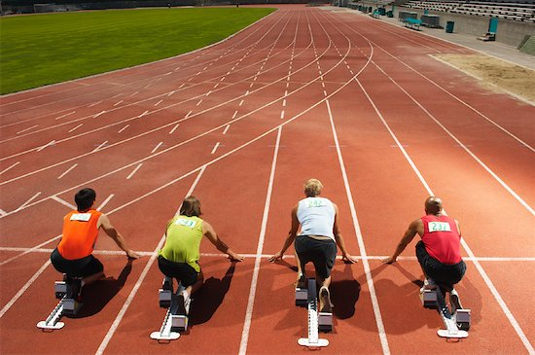
Applying
How does it look like?
From mentor’s point of view
From student’s point of view
What could be improved?
Layout of the ideas page
The project ideas template:
http://wiki.tcl.tk/27201
Project proposals being disscussion about it ;)
Projects could be sorted by priority

Slide 8
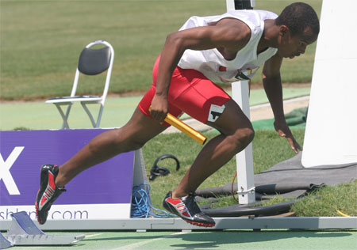
Startup
Outline (at least) project goals on tcl mailing list(s)
Skype
Consultations: up-to-date and relevant resources
Consultations: good IDE and tools

Slide 9
Tcl and other organizations
We as students
We as students had more experience how to work

Slide 10
What GSoC has given to us
View of what open source project looks like
Experience in time planning
Retrieving requirements
Got to know Tcl
Got to know real-life developers
English Polishing ☺
…

Slide 11

Q?

Slide 12
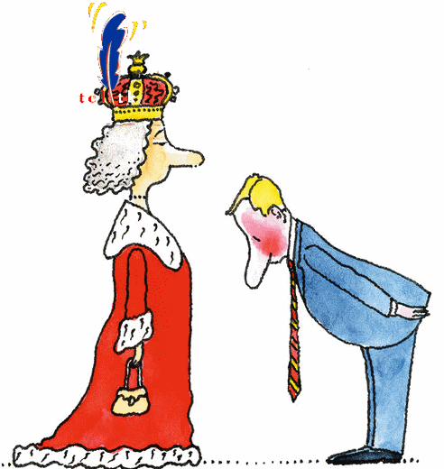
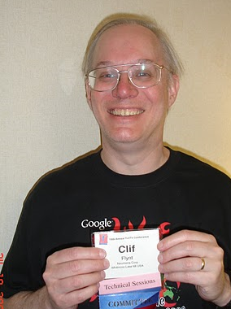
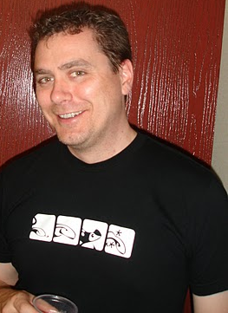
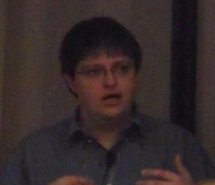
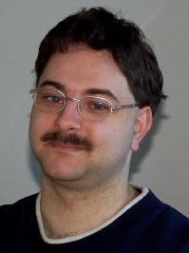
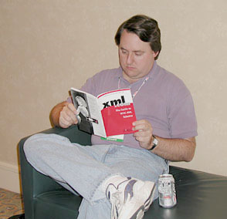
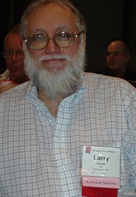

Dziękujemy - thanks
Jenke to Clif!
Jeff Hobbs
Donal K. Fellows
Donal Porter
Andreas Kupries
Larry Virden
And Tcl Organization

Slide 13
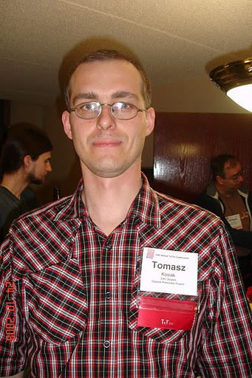
And special thanks to…
Tomasz Kosiak

Slide 14
Thank You Tcl

